Slide 1
19CS3113S
Analysis and Design of Algorithms
Session – 36

Slide 2
AND/OR Graph Decision Problem(AOG)
Many complex problems can be broken down into a series of subproblems such that the solution of all or some of these results in the solution of the original problem.
These subproblems can be broken down further into sub subproblems, and so on, until the only problems remaining are sufficiently primitive as to be trivially solvable.
This breaking down of a complex problem into several subproblems can be represented by a directed graph like structure in which nodes represent problems and descendents of nodes represent the subproblems associated with them

Slide 3
To solve OR node requires either all descendents to be solved or only one descendent to be solved.
To solve AND node requires all the descendents to be solved.
The AND nodes are drawn with an arc across all edges leaving the node.
Nodes with no descendents are called terminal. Terminal nodes represent primitive problems and are marked either solvable or not solvable.
Solvable terminal nodes are represented by rectangles.
An AND/OR graph need not always be a tree
A solution graph is a subgraph of solvable nodes that shows that the problem is solved.

Slide 4
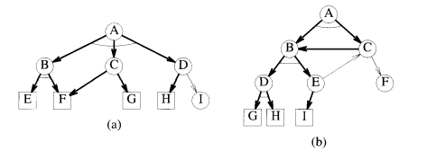

Slide 5
Let us assume that there is a cost associated with each edge in the AND/OR graph. The cost of a solution graph H of an AND/OR graph G is the sum of the costs of the edges in H. The AND/OR graph decision problem (AOG) is to determine whether G has a solution graph of cost at most k, for k a given input.

Slide 6
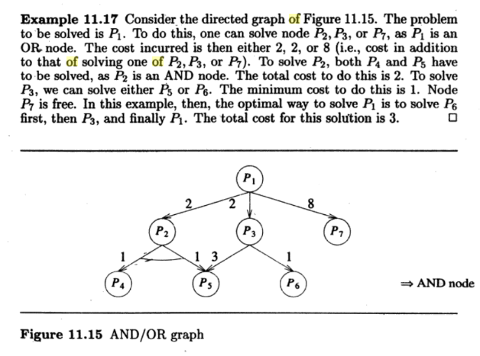

Slide 7
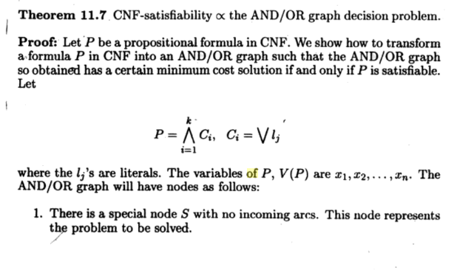

Slide 8
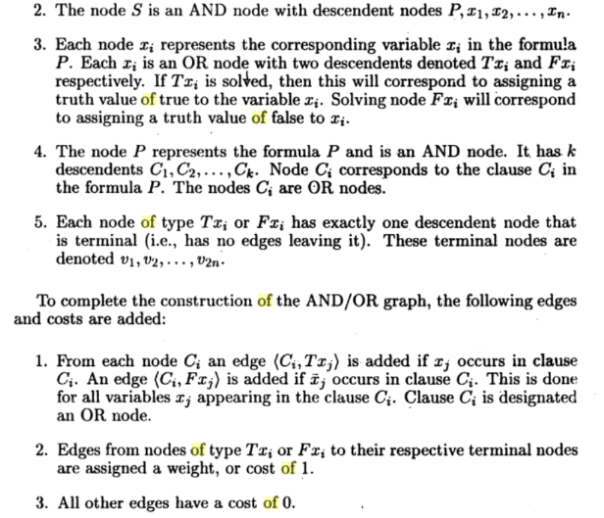

Slide 9
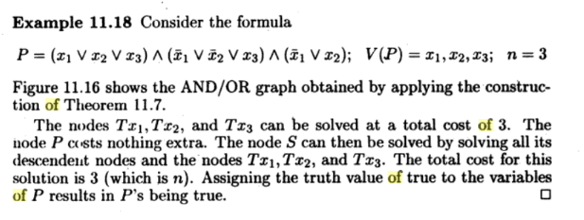

Slide 10
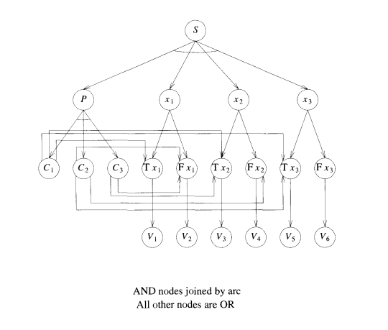

Slide 11
Thank you

